Slide 1
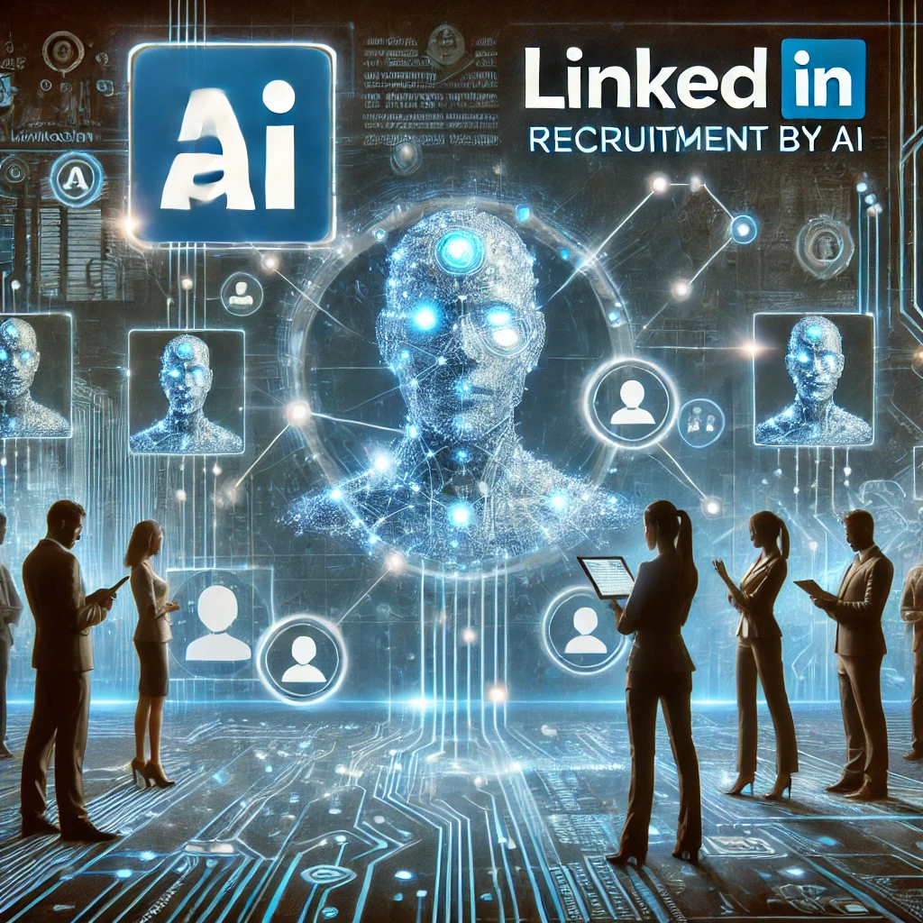
Leveraging AI Tools for Candidate Identification on LinkedIn
How technology is revolutionizing recruitment through the use of these professional networking sites.

Slide 2
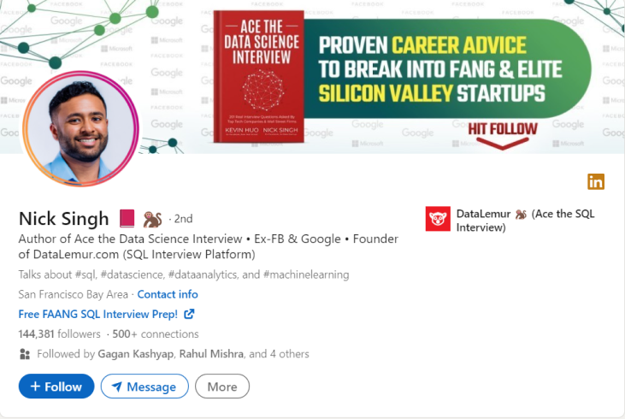
Introduction
🌐A total of over 900 million professionals are hosted globally at LinkedIn.
📊 Rich data: profiles, skills, endorsements, and connections.
🎯 A leading platform for targeted recruitment.

Slide 3

Challenges in Manual Candidate Search
⏳ Time-intensive to sift through large pools of profiles.
❓ Difficulty in matching candidates’ profiles to job requirements.
⚖️ Potential for unconscious bias in manual searches.

Slide 4
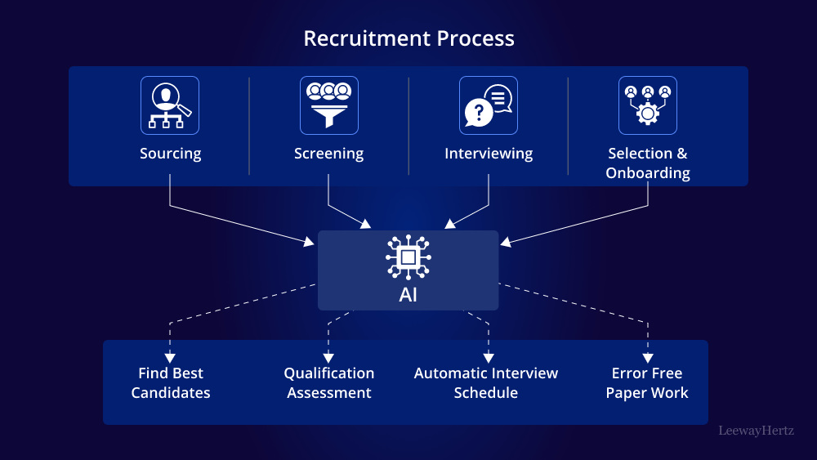
Role of AI Tools in Recruitment
- 🚀 AI speeds up the search process by analyzing data at scale.
- 🎯 Improves accuracy by matching candidates’ profiles to specific job requirements.
- 🤖 Reduces bias through algorithmic recommendations.

Slide 5
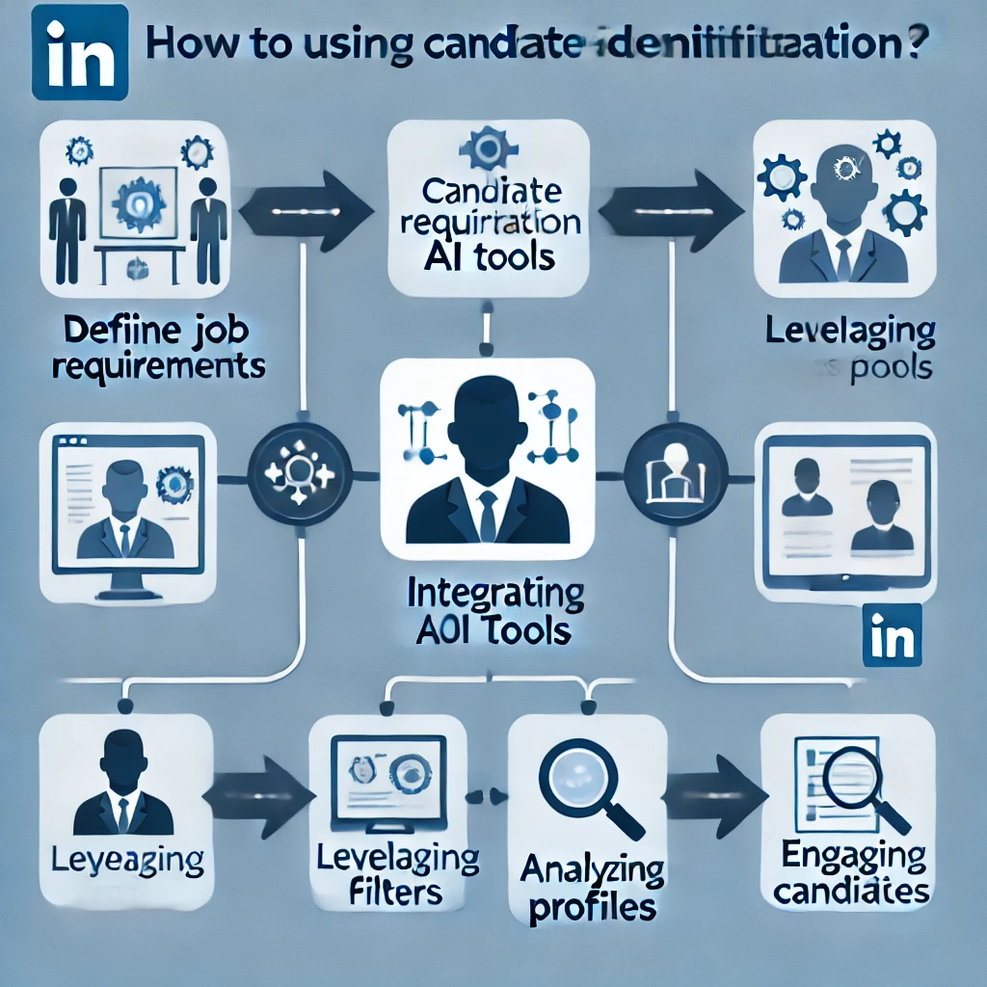
How to Use AI Tools for Candidate Identification
1. 📝 Define Job Requirements: Enter key skills, experiences, and roles.
2. 🛠️Integrate AI Tools: Use LinkedIn Recruiter and third-party AI plugins such as HireEZ, SeekOut.
3. 🔍Leverage Filters: Utilize AI-powered filters to screen candidates by location, industry, and experience.
4. 🧠Analyze Profiles: AI tools assess profiles for soft skills and cultural fit.
5. 💬Engage: Utilize AI-generated personalized messages to connect with potential candidates.

Slide 6




Popular AI Tools for LinkedIn Recruitment
💼 LinkedIn Recruiter: Advanced AI features for candidate search.
🤝 HireEZ: AI for talent sourcing and engagement.
🌟 SeekOut: Data-driven AI for finding diverse talent pools.
💡 ChatGPT: Crafting personalized outreach messages
.

Slide 7
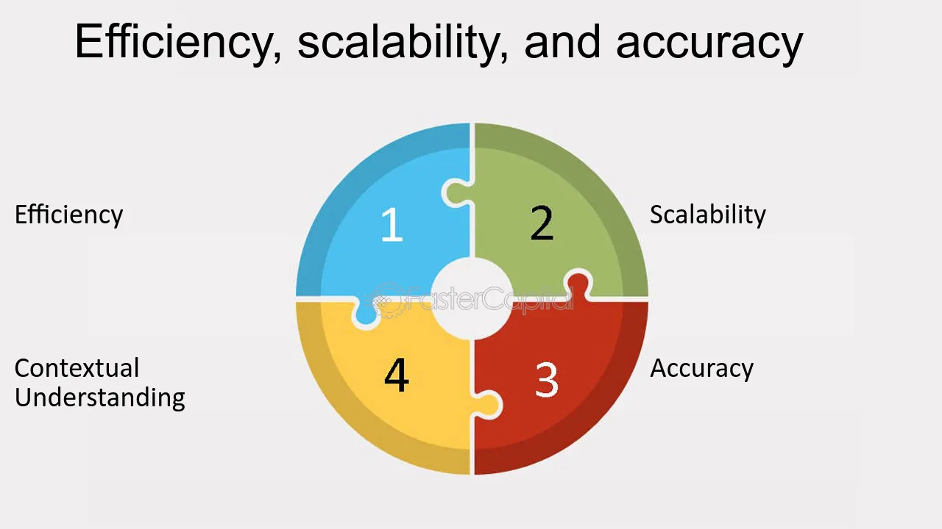
Benefits of AI-Driven Recruitment
⏩ Efficiency: Faster candidate shortlisting.
✅ Accuracy: Better matching of skills and roles.
🌍 Diversity: Identifies diverse talent.
📈 Scalability: Handles large volumes of data effortlessly.

Slide 8
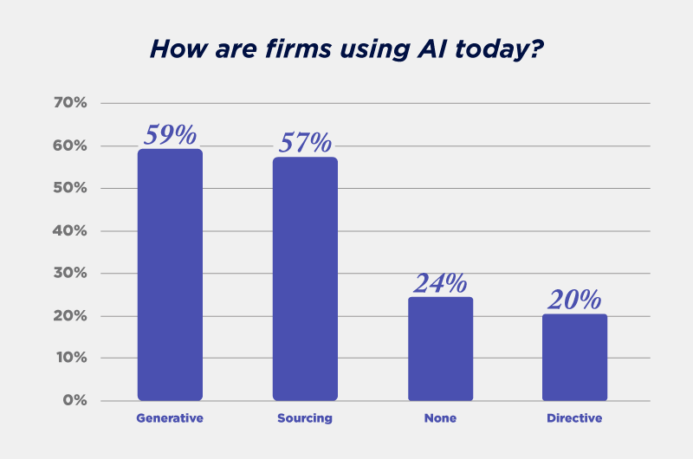
Real-Life Case Studies
Example 1: 📉 Company A reduced hiring time by 40% using AI on LinkedIn.
Example 2: 🌈 Company B increased diversity in hiring by 30% with AI tools.

Slide 9
Potential Challenges and Mitigation Strategies
📉 Reliance on data quality in LinkedIn profiles.
⚠️ Risk of algorithmic bias.
💰 High initial cost of AI tools.
Solutions:
🔄 Regularly update candidate data.
🛡️ Use AI tools with transparency and fairness metrics.
💡 Focus on long-term ROI.

Slide 10
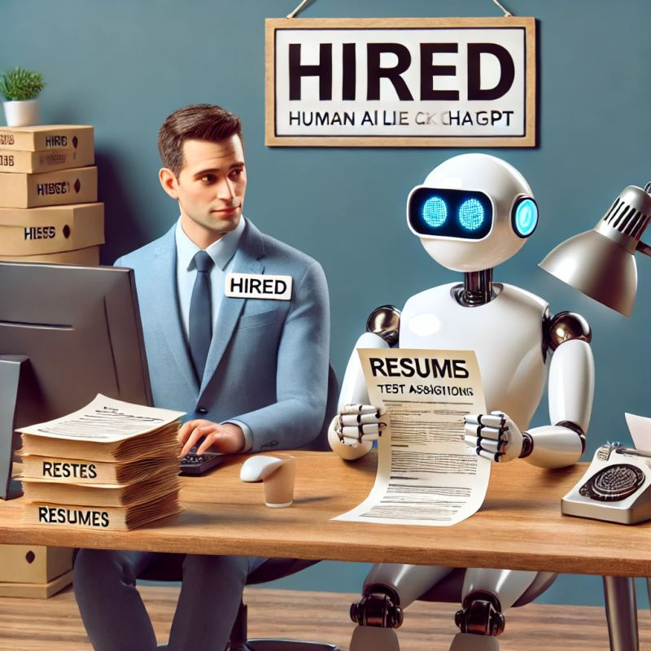
Conclusion
🤖 AI tools enhance LinkedIn’s potential for recruitment.
🔧 They streamline processes, improve accuracy, and support diversity.

